Slide 1


Introduction to HTTPS
HTTPS (Hypertext Transfer Protocol Secure) is a secure version of the standard HTTP protocol used for web browsing. It ensures that data transmitted between a user's browser and a web server is encrypted and protected from eavesdropping or tampering.
Presented by
Vemula Sameera
22H51A05C7
CSE-D

Slide 2
Importance of HTTPS
Privacy
Integrity
Trust
HTTPS encrypts sensitive information like passwords, credit card numbers, and personal data, protecting users from identity theft and fraud.
HTTPS verifies the website's identity, ensuring that users are communicating with the intended server and not a malicious imposter.
HTTPS builds user trust by signaling that a website is secure and committed to protecting its visitors' information.

Slide 3

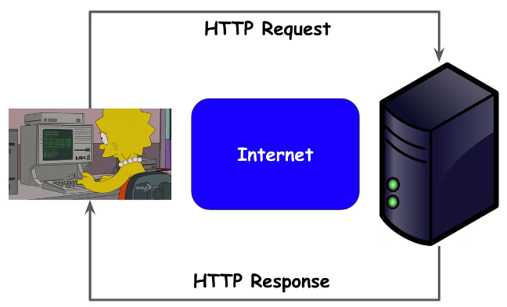
How HTTPS Works
1
Handshake
The client (browser) and server establish a secure connection by exchanging encryption keys and certificates.
2
Encryption
All data transmitted between the client and server is encrypted using the established cryptographic protocols.
3
Verification
The server's identity is verified using the digital certificate, ensuring the client is communicating with the intended website.

Slide 4


Implementing HTTPS on Servers
1
Obtain SSL/TLS Certificate
2
Configure Web Server
3
Enforce HTTPS
Update the web server's configuration to enable HTTPS and specify the location of the SSL/TLS certificate and private key.
Redirect all HTTP traffic to the HTTPS version of the website to ensure secure connections.
Acquire a valid SSL/TLS certificate from a trusted Certificate Authority (CA) to enable HTTPS on the web server.

Slide 5

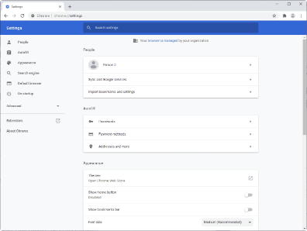



HTTPS Implementation on Clients
Secure Browsing
Security Warnings
Browser Updates
Browsers display a lock icon to indicate a secure HTTPS connection, providing visual confirmation to users.
Browsers will warn users if they attempt to access a website with an invalid or expired SSL/TLS certificate.
Regular browser updates ensure the latest security protocols and features are available for HTTPS protection.

Slide 6





HTTPS Troubleshooting
Certificate Issues
Verify the SSL/TLS certificate is valid, up-to-date, and issued by a trusted Certificate Authority.
Configuration Errors
Check the web server's HTTPS configuration, including protocol versions, cipher suites, and HSTS settings.
Client-side Problems
Ensure the client's browser is up-to-date and configured to support the latest HTTPS security features.

Slide 7


Conclusion and Best Practices
Use Strong Encryption
Prioritize TLS 1.2 or TLS 1.3 and strong cipher suites to protect against security threats.
Implement HSTS
Enable HTTP Strict Transport Security to enforce HTTPS and prevent downgrade attacks.
Maintain Certificates
Regularly renew SSL/TLS certificates and update server configurations to ensure ongoing security.
Monitor and Audit
Continuously monitor HTTPS implementation and audit for any security vulnerabilities or misconfigurations.

